Slide 1



DESIGNATHON 1.0
AUTOMATE RIT
RIT - BUS LIVE LOCATION AND ARRIVAL TRACKING
GIRIJAN D - AIML ‘A’ JEEVA M - AIML ‘A’
VARSHANI SV - AIDS ‘F’ VARUSHA A - AIDS ‘F’
VARNA OVIYA V - AIDS ‘F’

Slide 2
PROBLEM STATEMENT :
  Students dont know the exact bus arrival timings.
  Long waiting time and uncertainity.
  No real-time tracking system.
  No centralized transport monitoring system.
⟶ This leads to inefficiency and frustration.
01

Slide 3
OUR SOLUTION:
We develop a Real-time Bus Tracking System
KEY FEATURES:
  Live Bus Location tracking.
  Route Management.
  Arrival Time Logging.
  Admin Control Panel.
  Student Viewing Interface.
02

Slide 4
OBJECTIVES:
  Provide real-time location of buses
  Reduce waiting time for students
  Improves transport management efficiency
  Enable admins to monitor all buses centrally
  Maintain travel history and logs
  Communicating through APIs
  Route Visualization
  Real-time data update
03

Slide 5


SYSTEM ARCHITECTURE:
Frontend User Interface (map + data)
Backend Handles requests and logic
Database Stores buses, routes, locations
Flow : User ⟶ API ⟶ Database ⟶ Response ⟶ UI
04

Slide 6
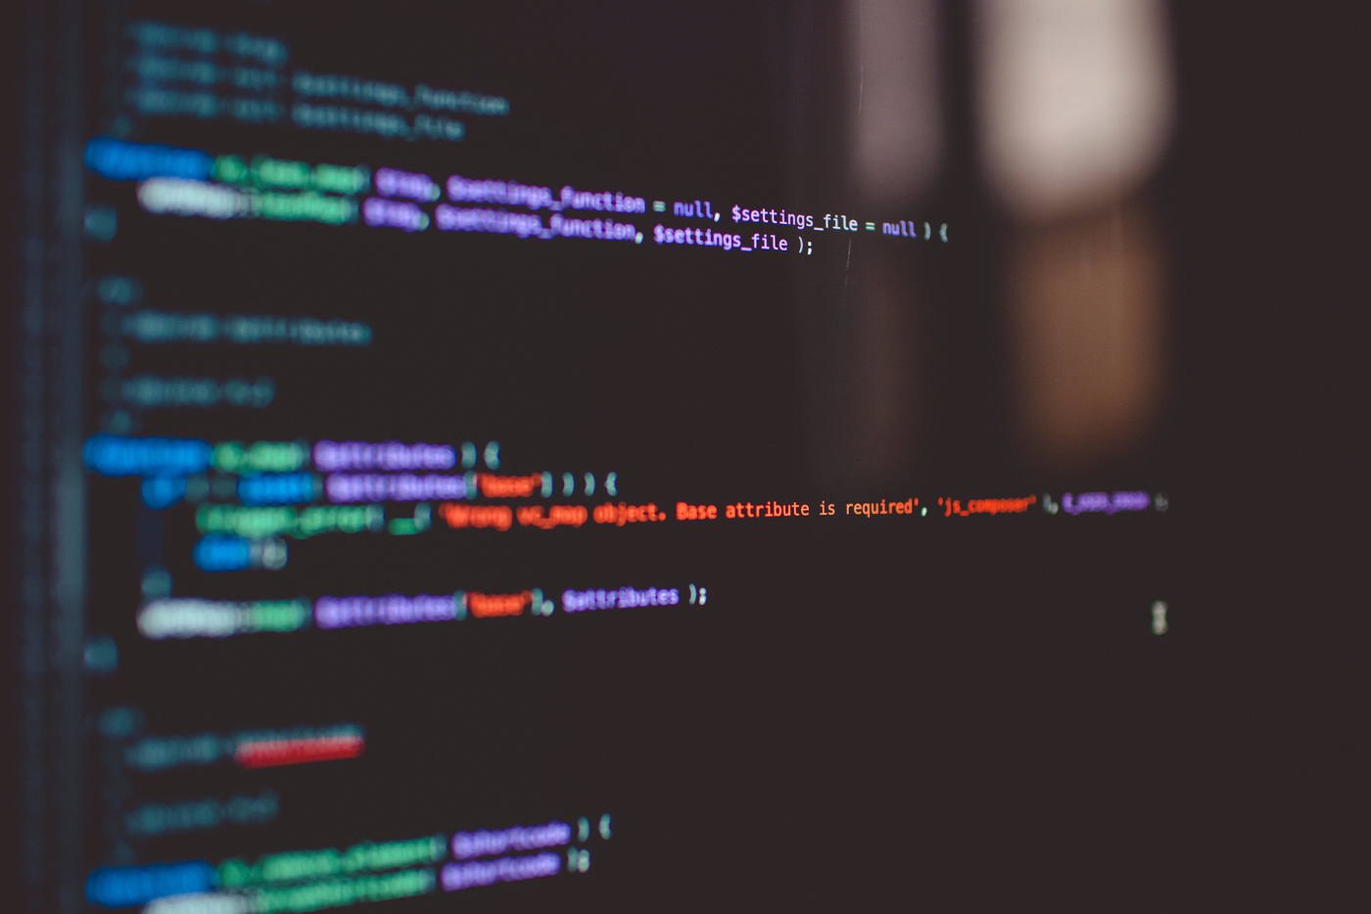
TECHNOLOGY STACK:
Frontend :
  HTML
  CSS
  JavaScript
Backend :
  Python (Flask)
Database :
  MySOL
Tools :
  VS Code
  Thunder Client (API Testing)
05

Slide 7
DATABASE DESIGN:
Tables Used :
  buses
  routes
  live_locations
  arrival_logs
06

Slide 8
HOW IT WORKS:
  Bus sends live location
  Stored in live_locations table
  Backend calculates distance
  Uses Haversine Formula
  Predicts arrival time
  Displays to user dashboard
07

Slide 9
IMPACTS & BENEFITS:
  Reduces waiting time
  Improves transport planning
  Helps staff and students
  Scalable for smart cities
  Supports data-driven decision
Conclusion :
This system makes campus transport smart, efficient and reliable
08

Slide 10
THANK YOU

